Slide 1
Credit Card Fraud Detection Using PyCaret
Franklin Anozie
11/09/2023
Notes:
Introduce yourself.

Slide 2
Outline
Goal
Using PyCaret
Conclusion
Q&A
Notes:
Slide 2: Outline (20 seconds)
- Mention the above.

Slide 3

Introduction:
In today's digital landscape, the rise of electronic transactions has given way to an increasingly concerning issue – credit card fraud.
Criminals are continually exploring new avenues to exploit vulnerabilities within payment systems, resulting in significant financial losses for both individuals and businesses.
As a result, the development of robust fraud detection mechanisms has become paramount.
Notes:
Slide 3: Introduction (20 seconds)
- Briefly introduce the topic and its importance.
We will discuss methods for detecting credit card fraud, a critical issue for financial institutions and consumers.
These systems can effectively flag suspicious transactions and take immediate action to mitigate potential financial losses.
Machine learning and artificial intelligence serve as pivotal tools within this domain, facilitating the creation of intelligent systems capable of learning from past fraudulent behaviors and swiftly identifying emerging fraud trends.
- Mention that we'll discuss traditional and PyCaret-based approaches for fraud detection.
- Set the audience's expectations by mentioning that you'll explore two methods for fraud detection.

Slide 4

Goal
“To accurately identify and isolate these fraudulent transactions within the dataset”.
Notes:
Slide 4: Goal (20 seconds)
Our aim is to derive a set of actionable insights and recommendations
that can assist the credit card company in implementing effective measures
to prevent unwarranted charges for their customers.

Slide 5
Approach
PyCaret Method
Overview
Why PyCaret?
High level workflow

Slide 6
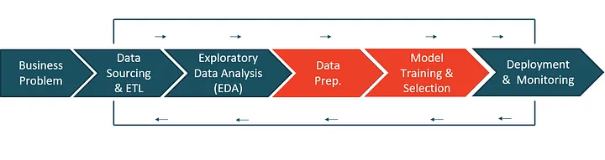
ML Lifecycle
Notes:
Slide Data Setup:
- Automation:
Emphasize that PyCaret automates various aspects of the machine learning workflow,
such as data preprocessing, missing values, outliers, and feature selection

Slide 7
Why PyCaret?
PyCaret is a versatile Python library designed for simplifying the end-to-end machine learning workflow.
Why PyCaret?
It is simple and easy to use.
It performs operations like EDA, Data preprocessing, feature engineering, Model selection, and hyperparameter.
Sequentially stores the operations in a Pipeline that is fully automated for deployment.
Notes:
Slide 5: Traditional Method (30 seconds)
- Mention that PyCaret is known for its user-friendly and intuitive interface,
making it accessible to both beginners and experienced data scientists.
It requires minimal coding, which was an advantage for our team.

Slide 8
Approach
High Level Workflow:
Data Setup: Loading and preprocessing the dataset.
Model Comparison and Selection: Comparing the results to identify the best-performing model for selection.
Model Training and Evaluation: Training models and access the performance of the models using various metrics..
Model Deployment (optional): Discussing the possibility of deploying the selected model in a real-world application.

Slide 9
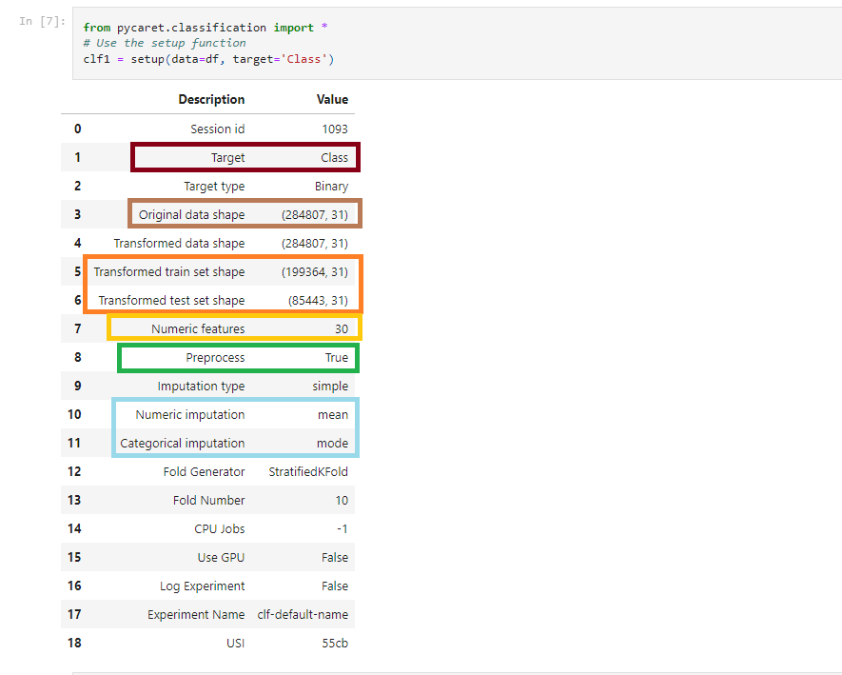
Data Setup
Notes:
Slide Data Setup:
- Automation:
Emphasize that PyCaret automates various aspects of the machine learning workflow,
such as data preprocessing, missing values, outliers, and feature selection

Slide 10
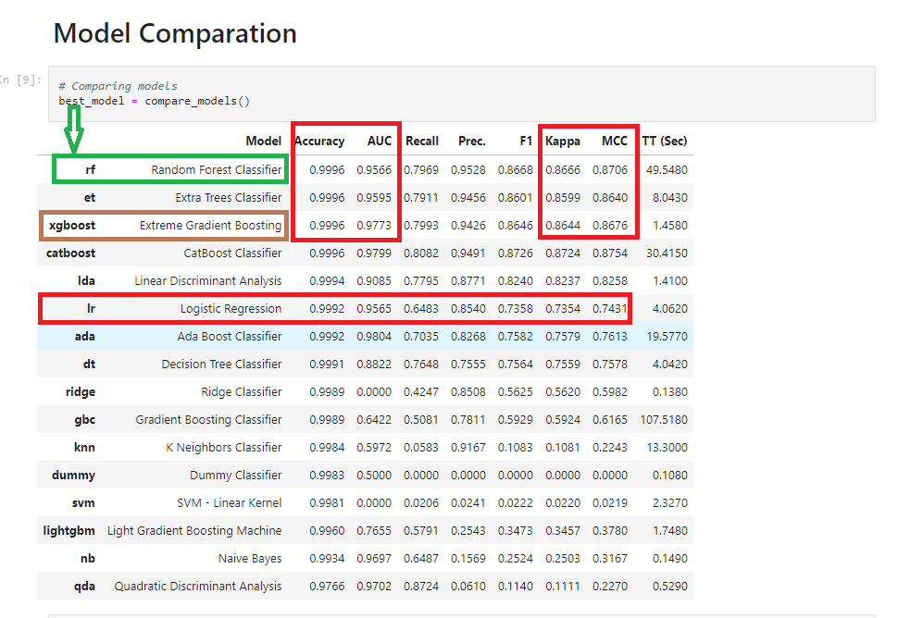
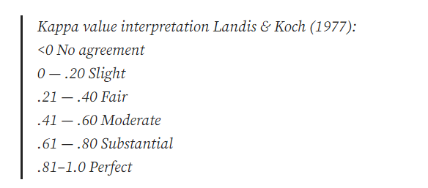
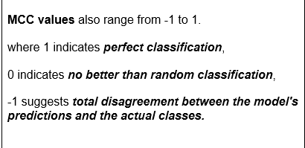
Compare & Select
Notes:
Slide Compare & Select: (30 seconds)
- Rapid Prototyping:
Point out that PyCaret allows for rapid prototyping and experimentation.
We needed a tool that would let us quickly try out different models and techniques to find the most effective solution.
Discuss the importance of having a wide range of machine
learning algorithms readily available within PyCaret.
This diversity allowed us to explore multiple approaches to fraud detection.
Stress reliability: "In our case, Kappa and MCC values demonstrated substantial agreement,
further assuring the model's reliability in fraud detection,
even after considering random chance."

Slide 11
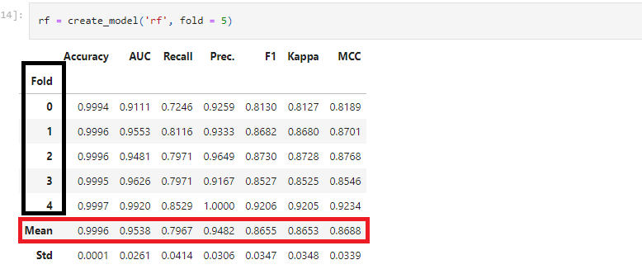
Train & Evaluate
Notes:
Slide Train & Evaluate:
Significance of Kappa and MCC Values:
Elaborate on Kappa and MCC:
"Kappa and MCC (Matthews Correlation Coefficient) values
suggest the level of agreement between model predictions and actual data.
They account for random chance, so values above zero signify meaningful agreement.“
Share the PyCaret results, where RandomForestClassifier was selected as the best model.
Emphasize that PyCaret identified RandomForestClassifier as the top-performing model.
- Present cross-validation accuracy, AUC, recall, precision, and F1 Score values.
The code creates and evaluates a Random Forest (RF) model using PyCaret.
The output you see is a tabular representation of the model's performance metrics,
which are evaluated over a 5-fold cross-validation.
List several important performance metrics, indicating the model's strength.
- Highlight a mean recall of about 79.7%, precision of approximately 94.8%, and an F1 Score of around 86.5%.
- Show that these key metrics demonstrate a balanced and effective model.

Slide 12
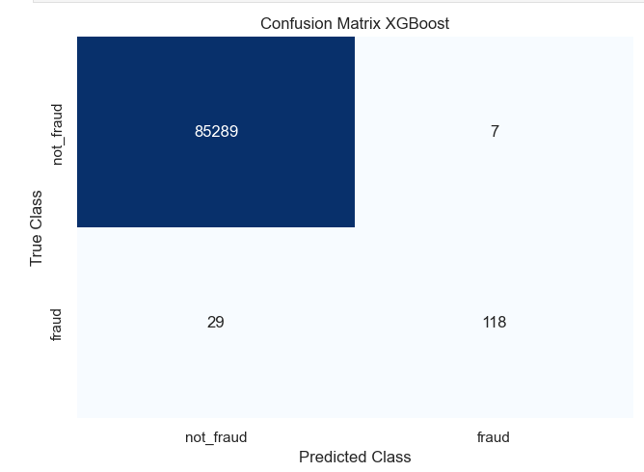
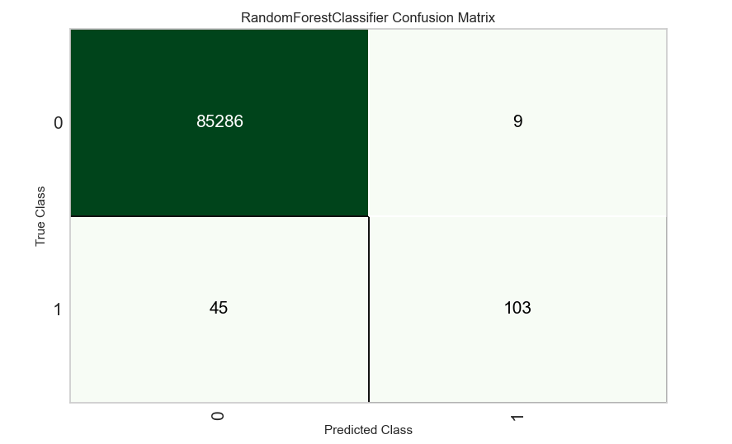
Results
Traditional (XGBoost Classifier)
PyCaret
AUC = 0.9995
Kappa = 0.8644
MCC = 0.8676
AUC = 0.9996
Kappa = 0.8666
MCC = 0.8706
Notes:
Kappa (Cohen's Kappa):
Kappa is a statistic that measures the level of agreement between
the predicted classifications of a model and the actual classifications in a classification problem.
It accounts for both the accuracy of the model and the possibility of random chance.
Kappa values range from -1 to 1,
where a value of 1 indicates perfect agreement, 0 indicates no agreement beyond chance,
and negative values suggest worse performance than random chance.
MCC (Matthews Correlation Coefficient):
MCC is another metric for evaluating classification models.
It takes into account all four values from a
confusion matrix (true positives, true negatives, false positives,
and false negatives) to measure the quality of the classification.
MCC values also range from -1 to 1,
where 1 indicates perfect classification,
0 indicates no better than random classification,
and -1 suggests total disagreement between the model's predictions and the actual classes.
In your case, both Random Forest and XGBoost models have high Kappa values,
with Random Forest having a slightly higher Kappa of 0.8666 and XGBoost having a Kappa of 0.8644.
These values suggest that both models perform significantly better than random chance in classifying credit card fraud cases.
In summary, both the Random Forest and XGBoost classifiers
have shown strong performance in your credit card fraud detection project,
with high Kappa and MCC values.
These results indicate that these models provide reliable and accurate
classifications for detecting credit card fraud, as they significantly outperform
random chance and exhibit strong agreement between predicted and actual classifications.
XGBoost
85,289 instances were correctly predicted as "not_fraud."
118 instances were correctly predicted as "fraud."
7 instances were incorrectly predicted as "fraud" when they were actually "not_fraud."
29 instances were incorrectly predicted as "not_fraud" when they were actually "fraud.“
PyCaret
85,286 instances were correctly predicted as "not_fraud."
103 instances were correctly predicted as "fraud."
9 instances were incorrectly predicted as "fraud" when they were actually "not_fraud."
45 instances were incorrectly predicted as "not_fraud" when they were actually "fraud.“

Slide 13
Conclusion:
PyCaret emerged as the ideal choice for our credit card fraud detection project.
It aligned with our project goals and simplified the machine learning workflow, determining both fraudulent and legitimate transactions, minimizing customer inconveniences and financial losses for both credit card company and its customers.

Slide 14

Questions

